Slide 1
The Benefits of ADO.NET in a MVC Application
By Mike Drozda & Dean Choi

Slide 2
The Benefits of ADO.NET
What is ADO.NET?
ADO.NET Architecture
Advantages of ADO.NET
Steps for Reading Data From a SQL Server Database
Demo of ADO.NET integrated into an MVC application

Slide 3
What is ADO.NET?
ADO.NET is a set of computer software components that programmers can use to access data and data services based on disconnected DataSets and XML that is part of .NET.
It is an evolution of ActiveX Data Objects (ADO) technology which was the common set of classes for interacting with databases.
It is part of the base class library System.Data namespace.
ADO.NET was built to serve both persistent and disconnected data needs.

Slide 4
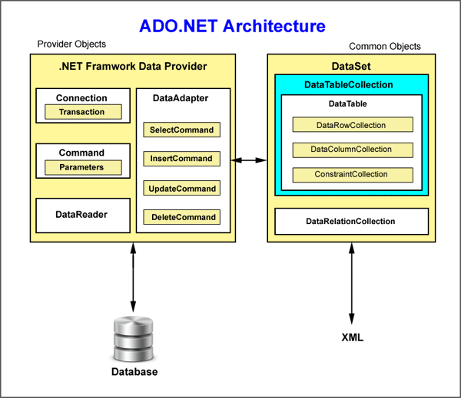
ADO.NET Architecture

Slide 5
What are the benefits of ADO.NET?
Interoperability
ADO.NET applications can take advantage of the flexibility and broad acceptance of XML.
Maintainability
Software architects can choose to divide the server's business-logic processing and user-interface processing onto separate tiers on separate machines. In effect, the application server tier is replaced with two tiers, alleviating the shortage of system resources.
Programmability
ADO.NET data components in Visual Studio encapsulate data access functionality in various ways that help you program more quickly and with fewer mistakes. ADO.NET’s robust data classes are generated by the designer tools result in typed datasets. This in turn allows you to access data through typed programming.

Slide 6
What are the benefits of ADO.NET (cont’d)
Performance
For disconnected applications, ADO.NET datasets offer performance advantages over ADO disconnected recordsets. When using Component Object Model (COM) marshalling to transmit a disconnected recordset among tiers, a significant processing cost can result from converting the values in the recordset to data types recognized by COM. In ADO.NET, such data-type conversion is not necessary.
Scalability
ADO.NET accommodates scalability by encouraging programmers to conserve limited resources. Because any ADO.NET application employs disconnected access to data, it does not retain database locks or active database connections for long durations.

Slide 7
Steps For Reading Data From a SQL Server Database
When using basic ADO.NET, there are a few steps to connecting to a SQL Server Database:
Create a connection
Create a command
Loop through the data reader
Close the reader
Close the connection

Slide 8
Our MVC application Demo
Goal: Display the total Order Information for a specific Order ID from the Northwind database including Company Name, Order Date, Product Details (ID, Name, Unit Price), Product Quantity, SubTotal (including discount) and Total Cost.
Secondary Goal: Create a Display All Orders List with Total Orders Count
Must:
Query the Northwind SQL Database to retrieve the data.
Convert and map DataReader data into C# objects and properties.
Display the new data in an MVC web application.

Slide 9
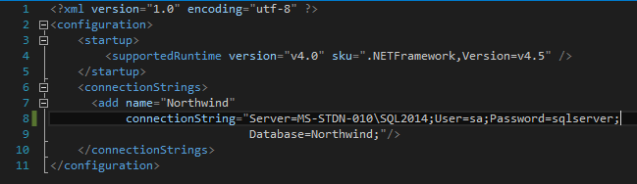
Connection String
Connection strings tell the connection class which server to connect to, what database to use, and specified credentials (login/pwd) if necessary.

Slide 10
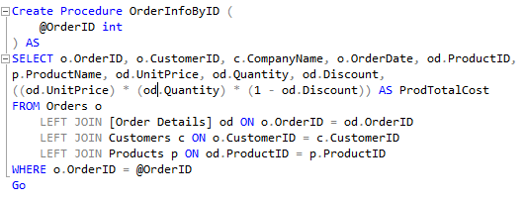
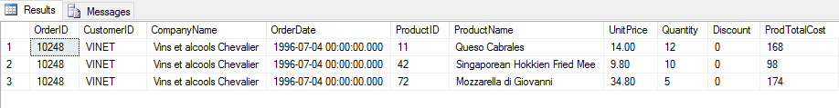
Create Our Stored Procedure
From Northwind Database

Slide 11
Conclusion
Any SQL Statement we can run in SQL Studio, we can also run from C# to select data.
Commands allow us the flexibility to call statements, call procedures, and add data to our calls to pass to the database.

